Slide 1
From brain to pitch
BRAINSFIRST CASE · RWCS 2026 · GROUP 5
Drills that exaggerate the match situations a player finds hard, with one thing to count so the coach sees whether it works.
Hugo · Esmee · Melina | Client reference version · 28 October 2026
Notes:
One-line position: BrainsFirst has the data, the coach has the pitch; the missing step is a drill change the coach can run tonight, for one to three players, with one behaviour to count.

Slide 2
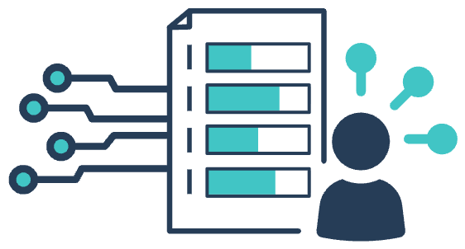
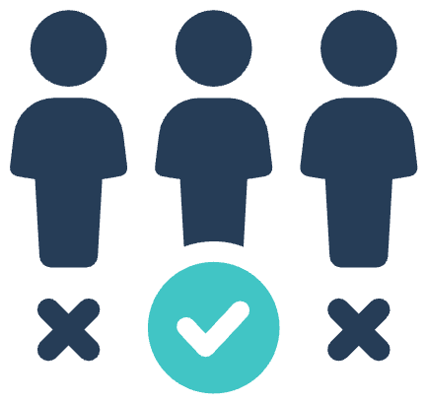


Three people in the club, three different decisions
USERS
Our user
CEO / CFO
Head of academy
Youth coach
Player and parents
DECIDES
DECIDES
DECIDES
DECIDES
Does this pay off over five to ten years?
Who progresses, and who needs what?
What do I change tonight, for which 1–3 players?
What do I work on?
NEEDS
NEEDS
NEEDS
A positive explanation, never a label
Academy players reaching the first team; transfer value
Age-corrected profile and trend per player
NEEDS
One card, one change, one thing to count
FORMAT
FORMAT
FORMAT
Squad overview per season
FORMAT
Talk with the coach
Yearly summary
Tablet on the pitch, under a minute
We build for the coach. The other three get a one-line answer from the same data, not a separate product.
Notes:
Maps the first bullet of the brief. The coach decides about tonight; the head of academy about progression; the board about return. Only the coach needs a new product in four weeks.

Slide 3

What the evidence lets us promise
EVIDENCE
≈ 0
So every card promises behaviour, not brain change
Transfer of computer brain training to untrained skills in children (g = 0.001; Sala & Gobet, 2020)
Drills change what players do: scanning, decisions, timing under pressure.
η² ≤ .015
Each card says what the drill exaggerates, not what it trains.
Effect of 10 weeks of NeuroTracker on game performance in 62 academy players (Romeas et al., 2025)
Each card names one behaviour the coach can count tonight.
g ≈ 0.65
We do not claim better match results. Nobody has shown that yet.
On-field effect of football-specific perceptual training: promising, but small studies (Zhu et al., 2024)
Notes:
Sources: Sala & Gobet 2020 (Psychonomic Bulletin & Review); Romeas, Goujat, Faubert & Labbé 2025 (Psychology of Sport & Exercise 76:102770); Zhu et al. 2024 (Behavioral Sciences 14:919); Kalén et al. 2021 (Psychological Bulletin). Moving training onto the pitch shortens the transfer distance but does not remove it.

Slide 4
Five rules to keep cognitive drills real football
DESIGN RULES
Load cognition through game information, not extra tasks
Arithmetic or memory tasks during a 3v3 cut tactical play in U13 players (Moreira et al., 2025).
1
Keep opponents, direction and goals
Unopposed patterns change what players look at; use them only as a short warm-up.
2
Change one thing, count one thing
One constraint per card and one behaviour to count, so the coach can see an effect.
3
An individual rule inside the team drill
Only Sam gets the scan-and-call rule; the others play the normal game. No extra sessions.
4
Set difficulty per player, keep instructions short
Five instructions hurt learning in low-working-memory children (d = 1.04; Buszard et al., 2017).
5
Notes:
Rules come from representative learning design, the challenge point framework (Guadagnoli & Lee 2004; Hodges & Lohse 2022) and dual-task evidence in youth football.

Slide 5
Weak or strong? A dial that turns with age
WEAK OR STRONG?
No study has tested whether training time should go to a weak or a strong function. The evidence supports a balance that shifts as executive functions mature.
8–11
12–14
15–18
18+
Our focus
Broad
Load moderate weaknesses
Compensate, use strengths
Decisions in context
Varied small games and other sports. Load every function, label no one. One extra rule at a time.
Individual constraints inside team drills at the right difficulty. First compensations for weaknesses that persist.
Automate routines: a scan before every reception, if-then options. Use strengths through role. Add pressure.
Executive functions are stable; football decision-making keeps improving. Train it in the game.
Floor rule. Never let one strength hide several severe weaknesses.
Profile is not a verdict. Act only when the coach also sees the behaviour on the pitch.
Notes:
Evidence: 'weaker executive functions gain most' (Diamond & Lee 2011) concerns test gains in 4–12-year-olds and is partly regression to the mean (Smoleń et al. 2018). Balanced profiles beat single extreme strengths in Swiss U13 players (Zuber et al. 2016). EF matures fastest between 10 and 15 and plateaus around 18–21.

Slide 6
One card = one change to a familiar drill
LIBRARY
7
5v2 rondo
Inhibition
Positional 4v4+3
Scanning
4v4 with four goals
Flexibility
Change No return pass to the player who just passed to you
Change Call the number shown behind you before receiving
Change After winning the ball, attack the other pair of goals
Exaggerates Stop the obvious pass, find the next one
Exaggerates Look away from the ball before it arrives
Exaggerates Switch the plan after every turnover
Count Illegal passes; losses after a closed lane
Count Scans before receiving; forward turns
Count Seconds to the first forward action
Evidence C
Evidence A
Evidence C
Every card: base drill · one change · one-sentence mechanism · which profile · what to count · evidence A (football study), B (other sport) or C (coaching logic). Target: 15–20 cards by Fri 13 Nov.
Notes:
Scanning evidence: Jordet et al. 2020 (Premier League, small effect on pass completion); Hintermann et al. 2025 (prompts raise scanning). The rondo and four-goal rules rest on coaching logic and are labelled C.

Slide 7





From card to visual in under 30 minutes
AI WORKFLOW
1
2
3
4
5
Card spec
Diagram
Animation
Check
Library
Structured fields: pitch size, players, the one change, what to count
Generated top-down pitch with the change in one colour
An 8–12 second loop of the change, from the same spec
A coach and BrainsFirst approve the wording and the claim
Tagged by function, age group and base drill
Generate from the spec, not a free prompt
Text-to-video only for mood clips
Same visual grammar on every card, and nothing invented that the coach would have to unlearn.
The drill itself always comes from the spec, so a new card can be checked against it.
Notes:
The workflow is the second deliverable in the brief. Esmee owns it; the success test is that BrainsFirst staff can add a card in under 30 minutes without the students.

Slide 8





The coach's view, and how we test it
PROTOTYPE AND TEST
Coach test, week 3
U14 · Tuesday 18:30
At least 5 youth coaches: PSV or AZ via BrainsFirst, plus 2 amateur clubs
3 players selected · tap to swap
Sam · scanning
Noor · inhibition
Daan · flexibility
Task: choose a card for three anonymised profiles
4v4+3 · call the number
Time to pick, target under 60 seconds
Rondo · no return pass
'I'll use this on Tuesday': yes or no, and why
Four goals · switch after regain
Fidelity: did they run it as designed, and what did they count?
Use tonight
Success: 4 of 5 coaches pick a card in under 60 seconds and run it in a real session.
Notes:
Proof of concept is usage, not effect. Fidelity and one behaviour count prepare the later effect study.

Slide 9
Who delivers what, and when
PLANNING
Fri 30 Oct
Fri 13 Nov
Hugo
Evidence and mechanisms
Evidence map: six functions by match situation, graded A, B or C. One page on what we can and cannot say.
Mechanism sentence, count and evidence label checked on every card. Coach one-pager on transfer.
H
Esmee
Drill library and AI workflow
Card template and six pilot cards (rondo, positional game, small-sided game, finishing). Workflow renders one card.
15–20 cards with generated visuals. Workflow documented: a new card in under 30 minutes.
E
Melina
Coaches and prototype
Stakeholder map checked with BrainsFirst. At least five coach sessions booked. Tablet wireframe v0.
Prototype tested with at least five coaches: time to pick, intent, fidelity. List of changes.
M
Fri 20 Nov, together: final pitch with live library, working workflow and coach test report.
Notes:
Each person owns one deliverable from the brief. Friday 30 October is a two-day sprint, so the first deadline is about scope and bookings; 13 November is the build-and-test checkpoint.

Slide 10


Our asks for Friday, and what we won't claim
ASKS
We need
We will not claim
The Football Brain labels and how they are explained to staff
That a drill trains inhibition or any other brain function
5–10 anonymised U13–U15 profiles for realistic examples
That the library improves match results
Introductions to youth coaches for sessions in weeks 2 and 3
That profiles should decide selection or playing position
A decision on who may see a minor's profile on the pitch
That a drill works before a coach has counted it
Proof of concept: coaches use it. Proof of effect: a later study across clubs and seasons.
Notes:
Close with the asks, so the client meeting ends with decisions.

